Slide 1


Creating a Save Haven for Pets, People and Entire Communities
One foundation dedicated to transforming the lives of rescue pets, the unhoused, and veterans in need

Slide 2
Creating Transformational Change for Pets, People, and Communities
While many worthy efforts have served rescue pets, veterans, and individuals in need, too few have delivered lasting transformational change. For too long, rescue pets have been hidden away in shelters, while veterans and those experiencing homelessness have too often been pushed from public view or defined by their circumstances.
The Paws-to-Share Foundation is changing that narrative. We are creating a welcoming, community-centered campus where pets and people find safety, care, purpose, and belonging. A place where rescue pets find loving homes, where veterans and individuals in need rediscover their value and potential, and where the community comes together to create brighter futures for all.

Slide 3
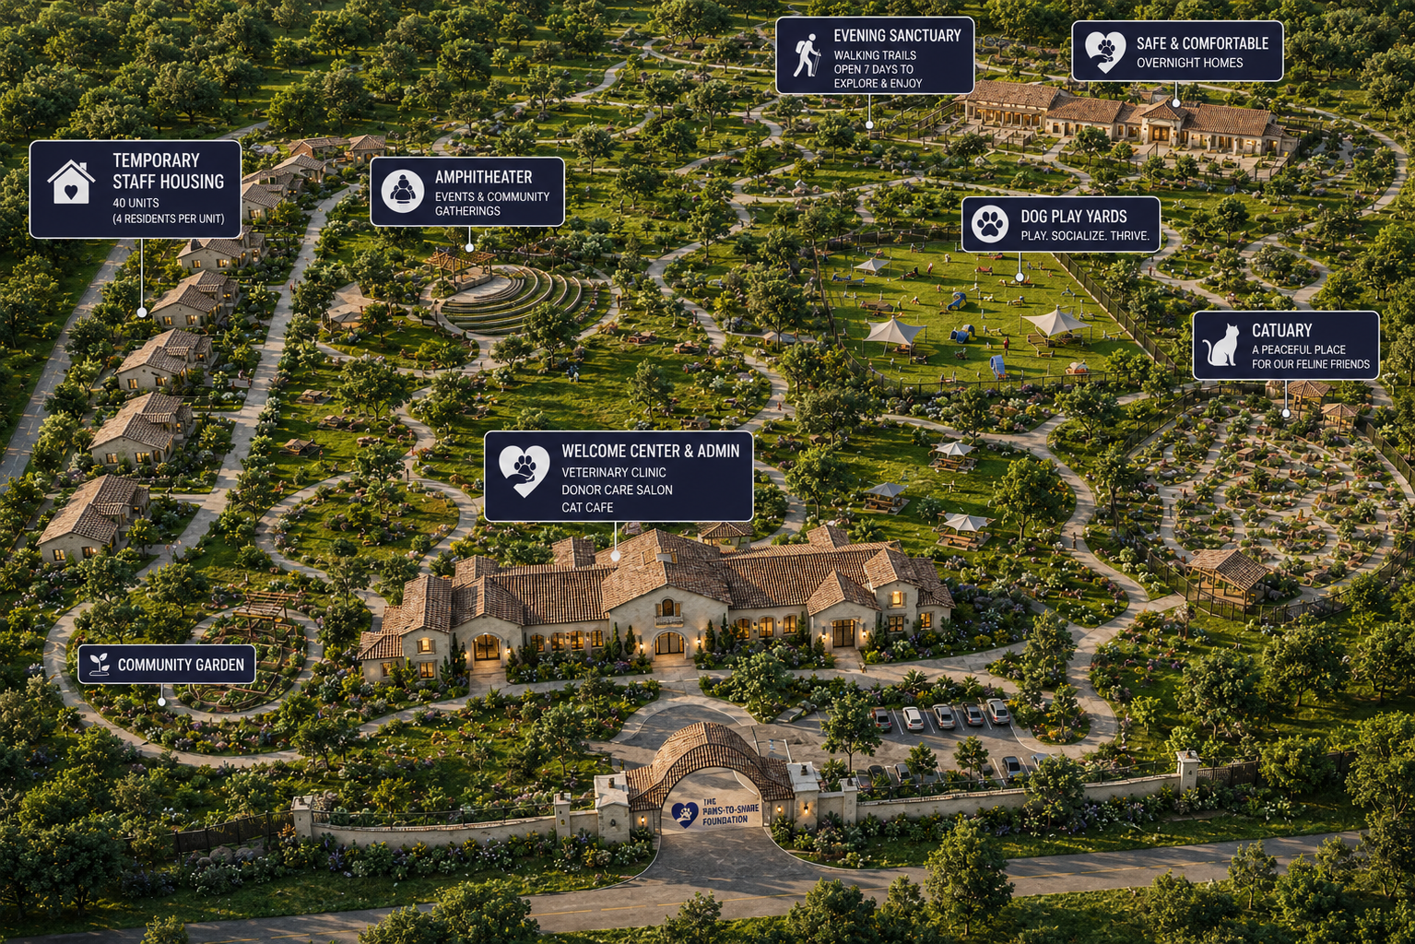
The Foundation's campus is designed as a fully integrated community where housing, training, counseling, animal care, and community engagement come together in one supportive environment. By providing all essential services on-site, the Foundation creates daily opportunities for connection, purpose, and growth, leading to better outcomes for both people and pets. Rather than simply providing assistance, the campus creates a pathway to lasting transformation through community, compassion, and shared purpose.

Slide 4
A New Model for Sustainable Impact
Three Mission Markets, One Unified Vision | A Community-Integrated Campus | Revenue-Generating Services with Community Benefit
Unlike most nonprofits that rely on a single funding constituency, the Paws-to-Share Foundation serves three complementary causes: Rescue pets and animal welfare Veterans in need The unhoused This creates access to multiple grant sources, corporate sponsors, philanthropic donors, and community advocates, significantly diversifying funding opportunities while supporting a shared mission of healing and belonging. | Most sanctuaries and transitional housing programs operate behind closed doors. Our model intentionally invites the community in. Visitors engage with pets, residents, and programs year-round Increased foot traffic creates greater awareness and donor engagement Thousands of small, recurring contributions become possible through ongoing community participation The result is a broader and more sustainable donor base than traditional fundraising models alone. | The Foundation is designed to provide affordable, mission-aligned services on a pay-what-you-can basis, including: Vaccination clinics Spay and neuter services Grooming services Dog training and behavior support Pet Wellness Programs These services create recurring revenue while simultaneously advancing animal welfare throughout the community.

Slide 5
Healing Lives, Strengthening Communities
Our Promise to the Pets in Our Care | Our Commitment to the People We Serve | Serving the Communities Who Welcome Us to their Neighborhood
Enjoying healthier and happier lives Improved care through in-house training, veterinary and grooming services More human connection and socialization More pet to pet connection, through positive interactions Enjoying a ‘home-like’ environment while in the process of finding a forever home Significantly higher changes of being adopted Significantly faster rates of adoption Better matches to those adopting households Significantly reduced rates of returning to the Foundation | Helping renew a sense of purpose and self Helping develop a sense of believing comfortable being a fit in the world around them Providing a sense of community while on the Foundation campus, and after becoming a graduated of the Foundation Providing support services in one-on-one models, and social models, reducing the sense of isolation Creating a ‘college-like’ atmosphere at the Foundation so our staff feel welcomed, not like they are being punished. Enhancing the probability of long-term positive outcomes through career paths to fit their interests | Creates a welcoming community where connection replaces isolation and loneliness Brings people of all ages and backgrounds together through compassion and shared purpose Strengthens social bonds and fosters a deeper sense of belonging Inspires volunteerism and community engagement Creates opportunities for healing, hope, and meaningful human-animal connections Reinforces that veterans and the unhoused are valued members of our community, deserving of dignity, opportunity, and connection Builds stronger, more compassionate communities where both people and pets can thrive

Slide 6
Mission-Driven Events That Generate Ongoing Revenue | Diversified Income Beyond Traditional Donations | The Result: A Self-Reinforcing Funding Ecosystem
The campus itself becomes a destination for community engagement: Outdoor concerts and performances Family movie nights Farmers markets Food truck nights Educational workshops and classes Adoption and community festivals These activities generate revenue, increase visibility, strengthen community connections, and create new donor relationships. | To reduce dependence on grants and annual fundraising campaigns, the Foundation incorporates multiple revenue streams: Conference room rentals Day office rentals Corporate retreats and team-building events Multi-day corporate gatherings On-site lodging accommodations for approved programs and events Sponsorship opportunities throughout the campus | Most nonprofits often depend heavily on annual fundraising and grants. The Paws-to-Share Foundation is being designed as a diversified social enterprise that combines: Philanthropic Giving Grant Funding Community Donations Service Revenue Event Revenue Facility Rentals Corporate Partnerships The goal is simple: create a financially resilient model capable of sustaining and expanding Foundation services for decades to come.

Slide 7
Join Us in Redefining What Is Possible
The Paws-to-Share Foundation is seeking visionary cities, charitable organizations, corporate partners, and generous individuals who are willing to rethink what is possible. We believe the challenges facing rescue pets, veterans, individuals in need, and our communities are deeply interconnected—and that meaningful change requires a new approach. Together, we can build an innovative, transparent, and self-sustaining model that not only improves lives, but redefines how they are changed for generations to come.

Slide 8
Founding Partnership & Sponsorship Opportunities
Community Partner — $10,000+ | Support community outreach, educational programs, adoption events, and volunteer initiatives.
Program Partner — $25,000+ | Support workforce development, counseling services, participant support, and life-skills programs.
Campus Partner — $50,000+ | Support animal care, veterinary services, enrichment programs, training facilities, and community spaces.
Legacy Partner — $100,000+ | Support workforce development, counseling services, participant support, and life-skills programs.
In-Kind Community Partner | A city, county, or public agency that supports the Foundation through the donation of land, facilities, infrastructure, permits, professional services, or other non-cash resources.

Slide 9
To Learn More About the Paws-to-Share Foundation
Jaime Goldfarb, Ph.D.
President/Founder
The Paws-to-Share Foundation
jgoldfarb@thepawstosharefoundation.org
www.thepawstosharefoundation.org
888.695.6845

